Slide 1
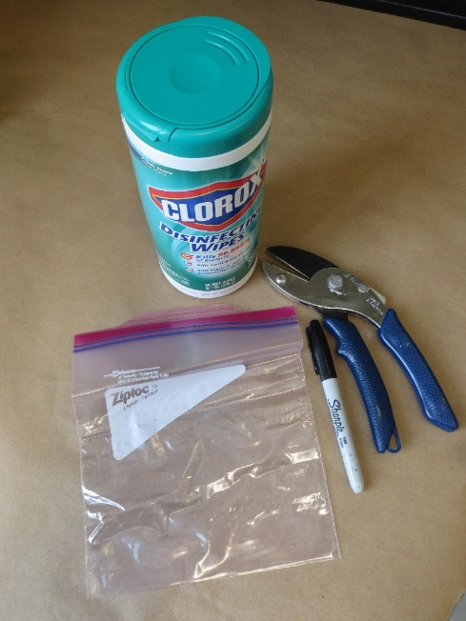
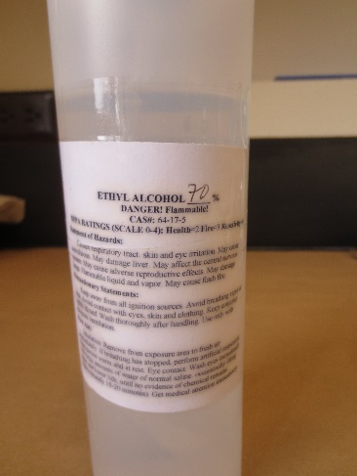
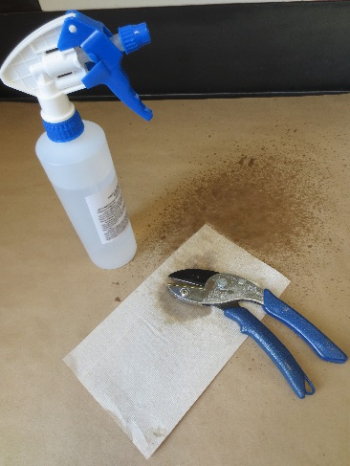
Sample Collection Needs
-Shears, clippers or a knife to collect tissue
-Disinfecting wipes or sanitizer and disposal paper towels to wipe tool blades between plants
-Plastic bags to hold samples (one sample or plant per bag only)
-Permanent marker to label samples
Instructions/Handling:
Tomato foliage does not hold up well under refrigeration, and it may not be likely that you will have ready access to one or more infected tomato plants at the time that you wish to perform this training. For this training, it may be best to have potted plants that have been inoculated with the pathogen prior to the planned time for the training.
As an alternative, plan the class for August-September and ask participants to bring in fresh samples from their own tomato or potato garden plants to share with the class.
Keep individual samples from individual plants in separate plastic bags and label each bag with a permanent marker, including sufficient information for sample identification.
Keep entire plants watered and in a cool location until use. If foliage is collected one or more days prior to the training, keep in a cool locations but do not refrigerate. Include a slightly damp (very well wrung out) paper towel to provide minimal moisture and keep humidity high..

Slide 2
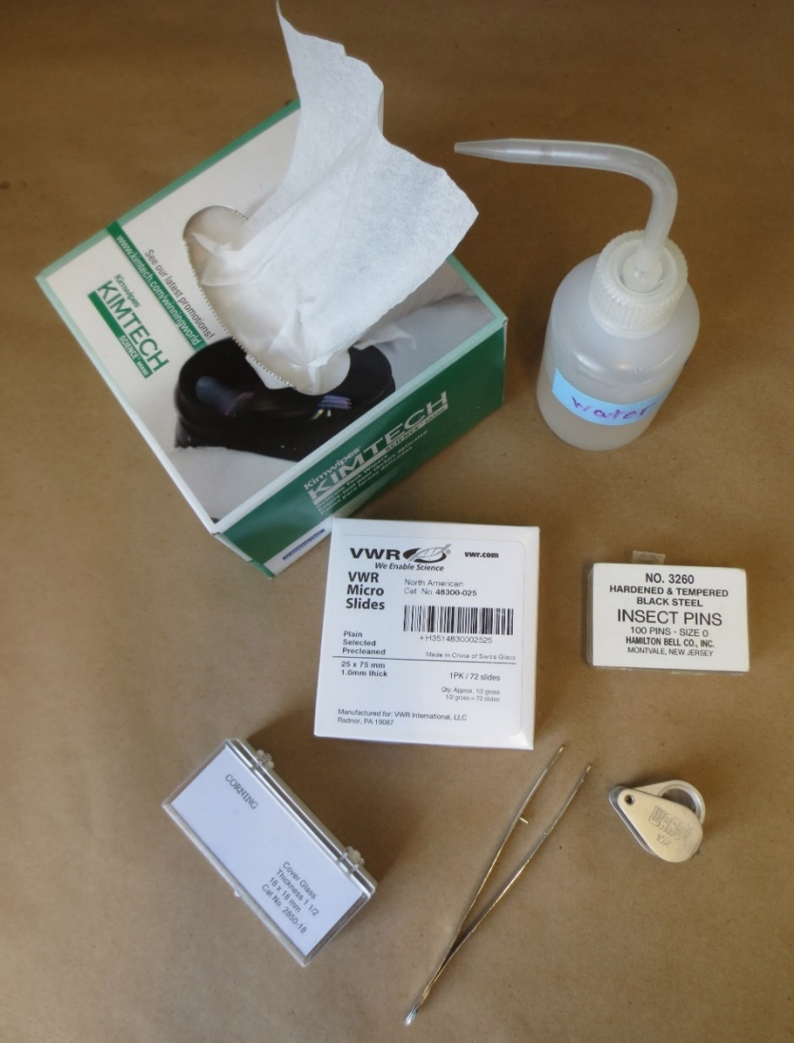
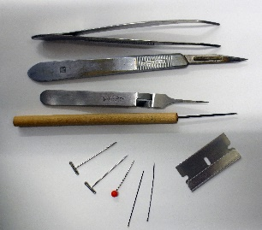
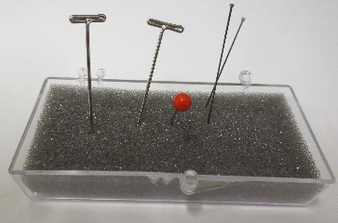
Sample Processing: Supplies & Use!
Disposable paper towels or wipes: Place small sample on a disposable wipe to view under the dissecting microscope. This helps to make moving the sample easy, limits the mess if leaves are falling off, and keeps spores off your microscope stand.
Tweezers or forceps: You can use one to pull individual leaves off of the tissue to take a closer look. It doesn’t hurt to have two pairs –one to hold the sample and another to pick off the desirable tissue.
Fine tip water bottle or eye dropper: Use this to limit how much water you add to the slide. Too much water and the cover-slip may push your sample right off of the slide!
Microscope slides and cover slips: We do suggest the smaller cover slips so you can use about 3 per slide.
Don’t forget the microscopes!
Other items that may come in handy…
A hand lens or magnifying glass to scan a larger sample for symptomatic tissue.
Small tip dissection tools such as insect pins or needles. Be sure to have a pin cushion so you can keep track of these while you work!
A scalpel with fine tip blade or single edge razor blade is not just useful to pick up small bits of tissue but handy of you need to cut away excess plant tissue to be able to focus on a smaller area.
Small dishes with clear lids if you need to set up tissue in a moist chamber to re-examine later.

Slide 3
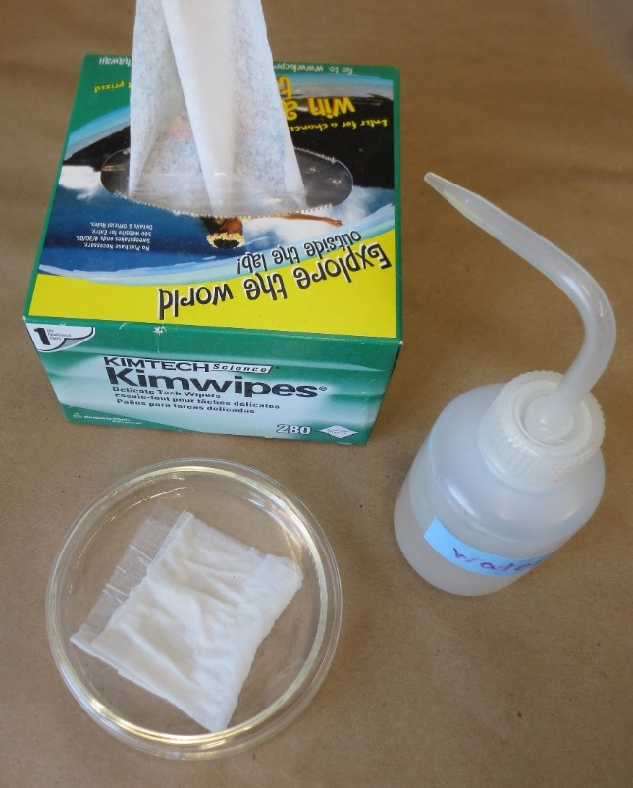
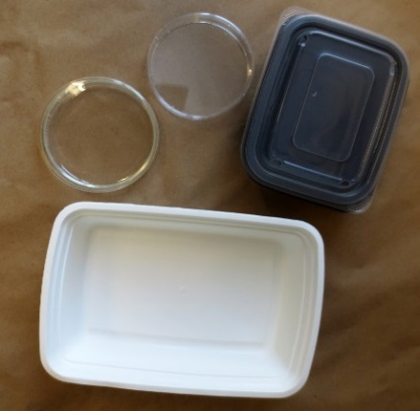
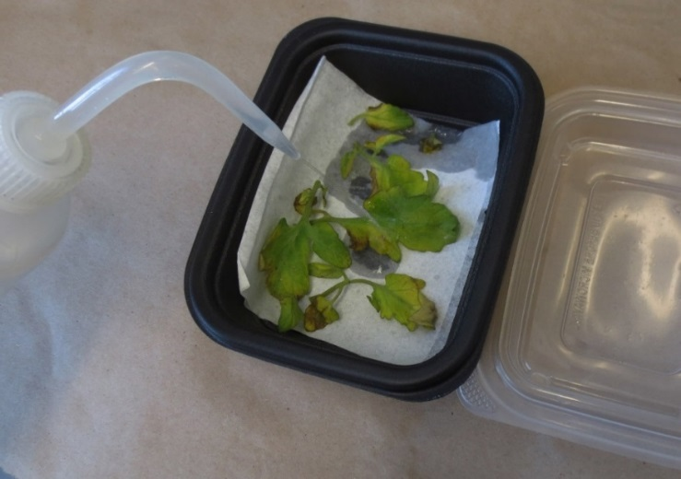
Setting up a Moist Chamber for Late Blight
If you cannot confirm the presence of the pathogen from a fresh sample, set up at least one moist chamber containing tissue exhibiting suspect symptoms of the pathogen.
Do this no more than 1-2 days before you know you will be able to re-examine the tissue.
If symptoms are good and tissue can be examined daily, a single moist chamber with symptomatic tissue may be adequate. If you know you can’t get back to the sample for a few days, it may be best to set up two or more moist chambers. If you have adequate tissue set up moist chambers to incubate at different temperatures.
For large samples, use containers such as plastic bins with good lids; containers do not need to be airtight for the incubation process but need to preserve high humidity.
Place individual leaflets or larger leaves exhibiting any foliar lesions into the container; try to minimize overlap of individual leaflets.
The pathogen may sporulate on either upper or lower leaf surfaces, but may sporulate more prevalently on the lower surface so be certain to place some leaflets bottom side up.
Notes:
Handout: Setting up a moist chamber

Slide 4
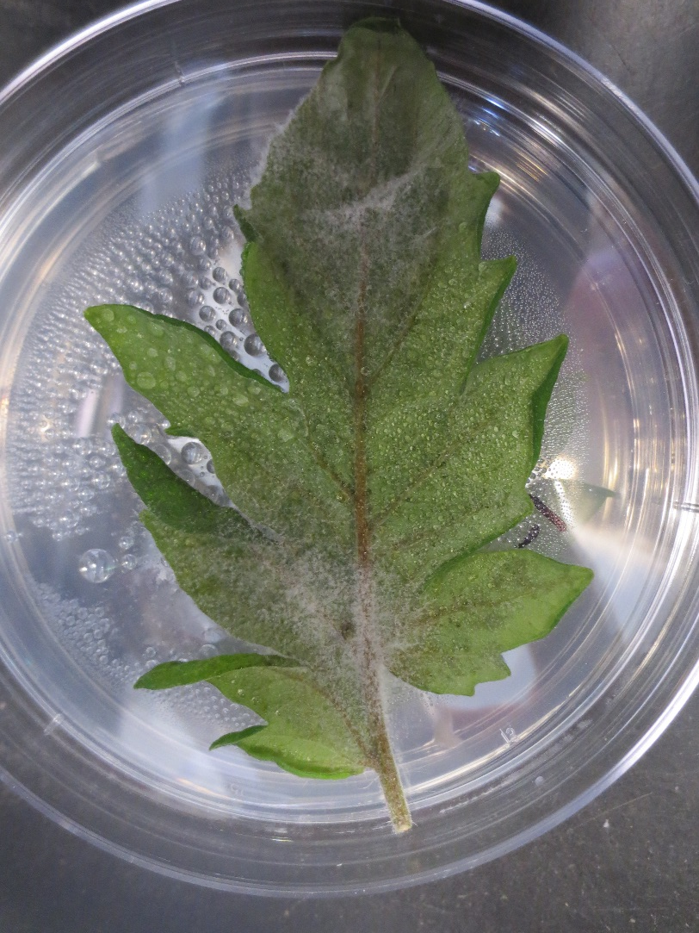
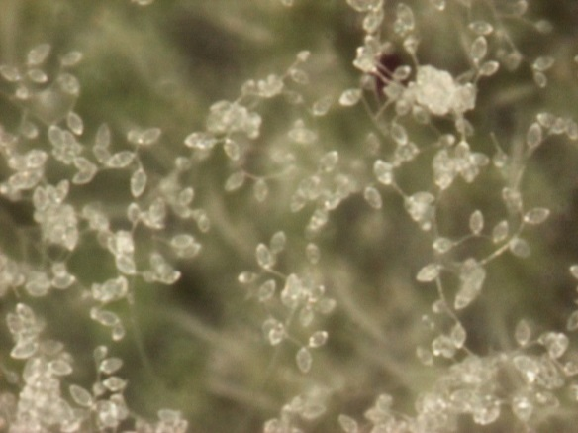
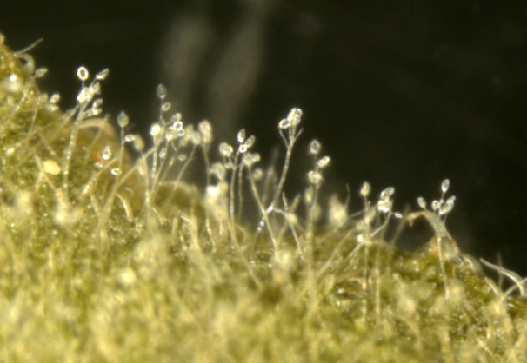
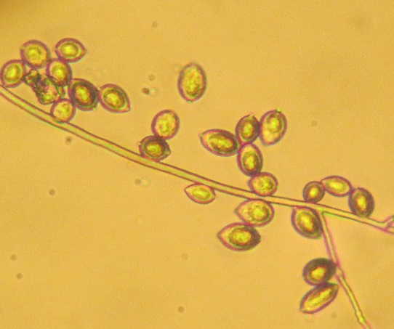
If setting up samples from more than one plant or location – don’t forget to label each separate sample!
Keep in mind that P. infestans grows best at temperatures between 50º and 80º F., so incubate samples where the temperature will stay within that range! High temperatures can kill the pathogen.
Examine tissue daily, if possible. Use a dissecting microscope first to look for sporangia developing from foliar lesions. Make a slide of suspect growth to verify that sporangia are consistent with P. infestans (lower right photo).
The photo to the right shows the pathogen growing on a leaf surface. Photos below show a progression of views of sporangia under increasing magnification.
Sporangia

Slide 5
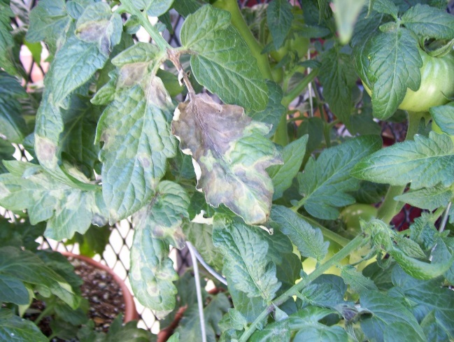
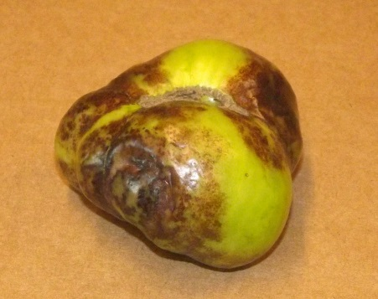
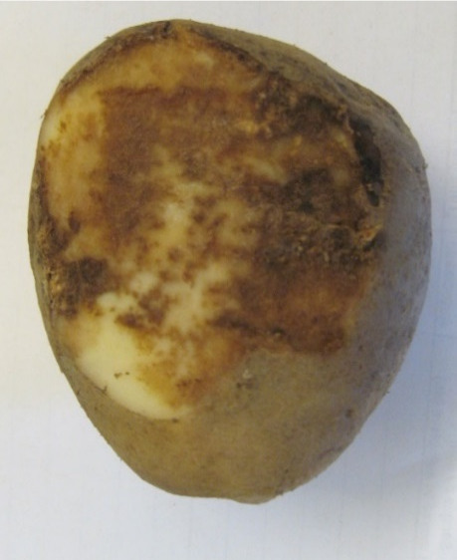
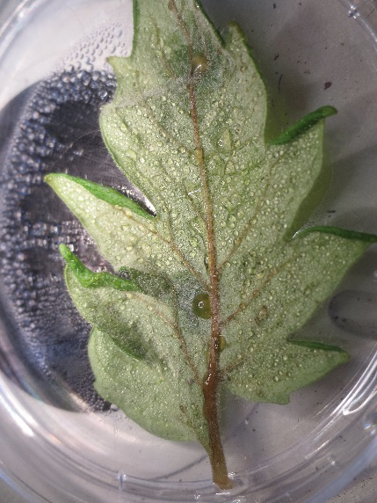
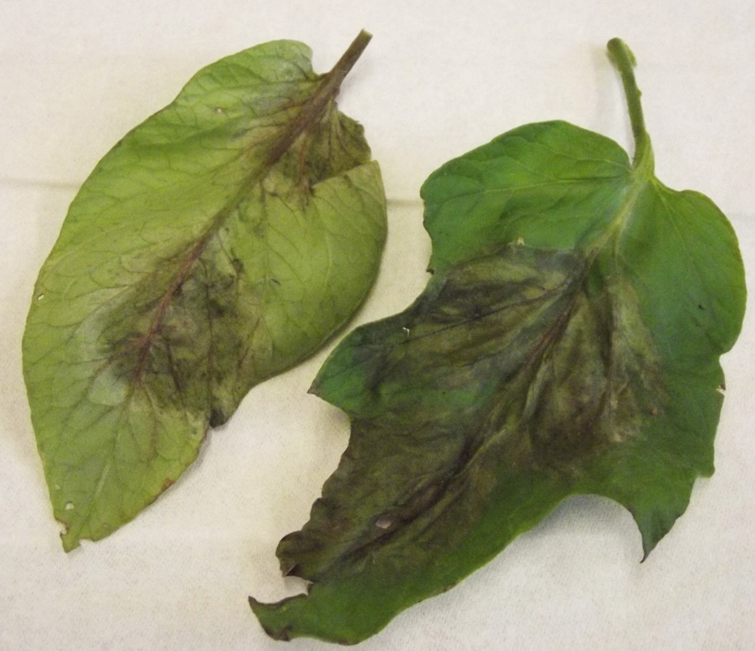
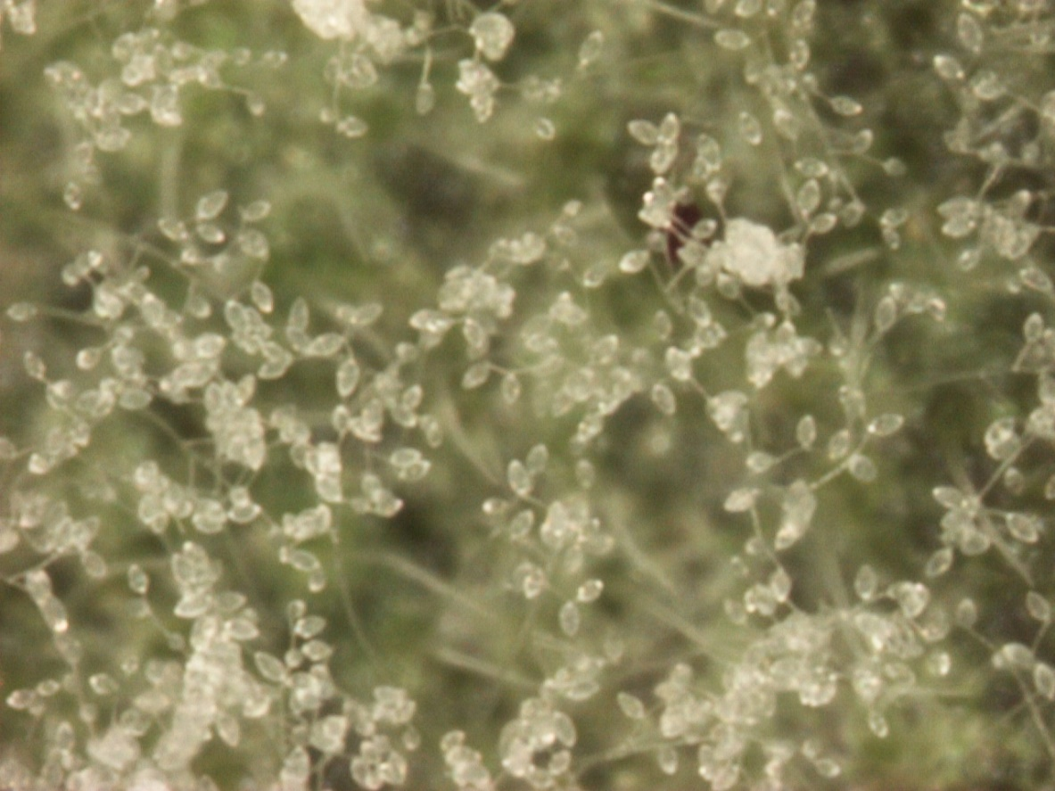
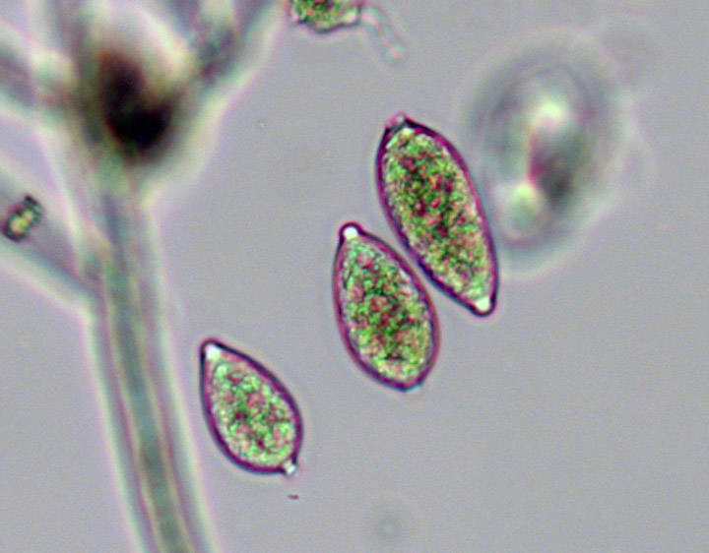
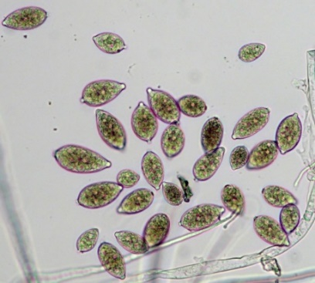
Tom Zitter
Phytophthora infestans sporangia

Slide 6
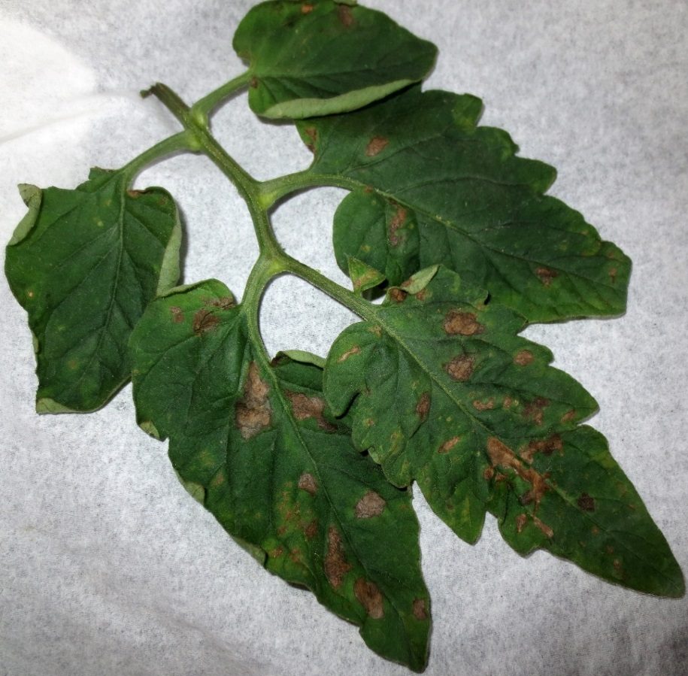
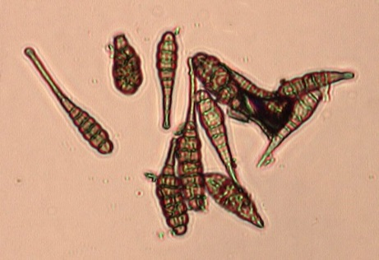
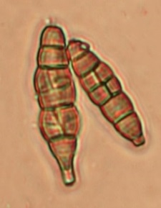
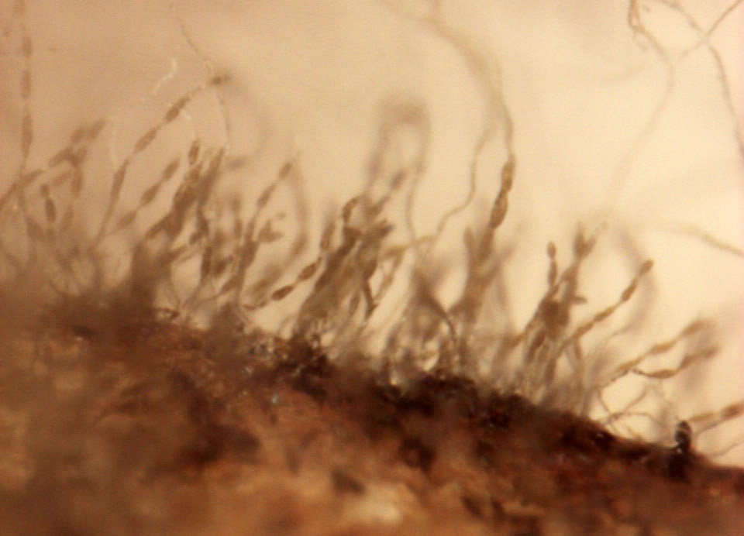
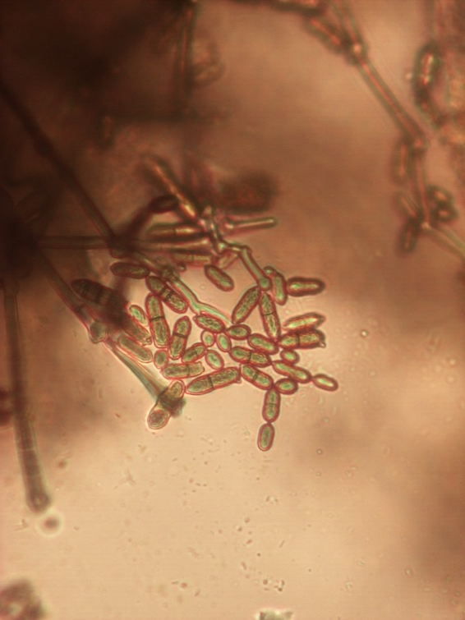
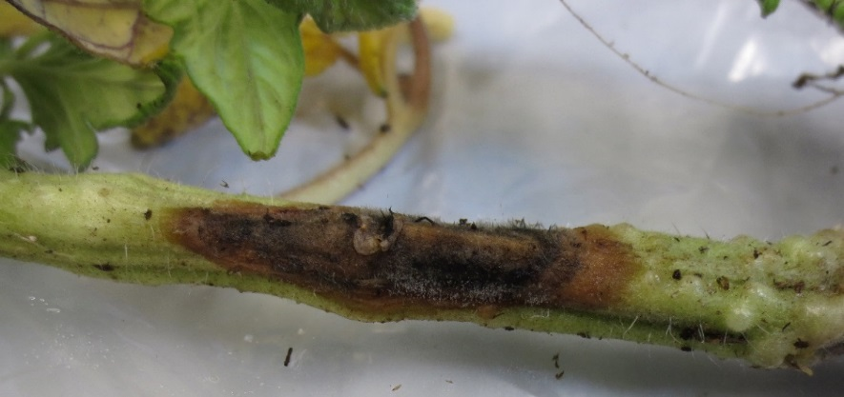
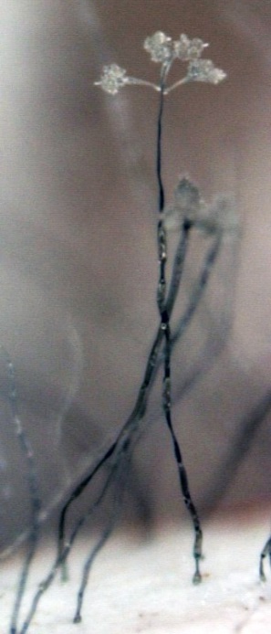
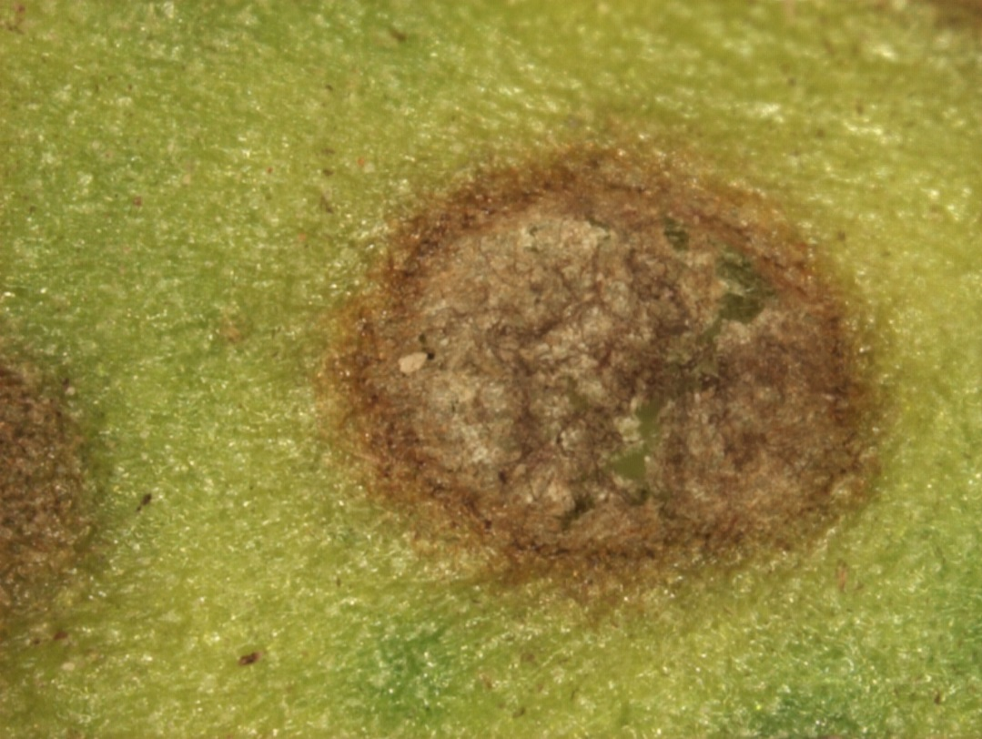
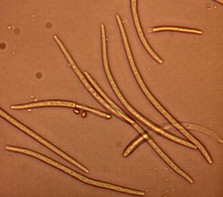
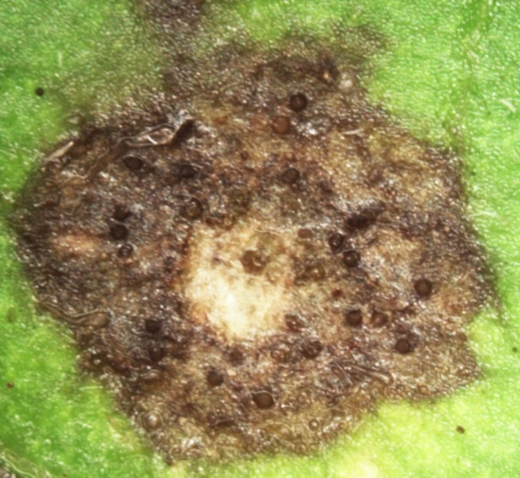
Alternaria
Alternaria
Alternaria
Botrytis
Cladosporium
Botrytis
Septoria
Cladosporium
Septoria

